Slide 1
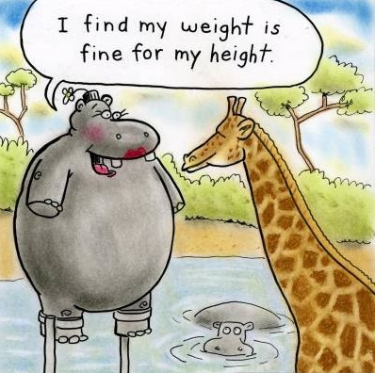
Entering Anthropometry Form
Anthropometry forms >> Interviewers

Slide 2
What?
Why?
When?
Who?
How?
Entering the anthropometry data collected for eligible women/children
Anthropometry data collected on paper, data must become electronic
Once all women/children have been measured
First interviewer for the household
Enter into CAPI system

Slide 3
Fieldwork Flow – Anthropometry
Arrive in cluster, Identify households
Interviewers carry out module interviews, collect height/weight
Supervisor assigns households
Interviewers send data to supervisor
Interview HHs, identify eligible individuals
Team resolves structural problems
Interviewer A assigns modules to Interviewer B
Supervisor submits data to central office
Notes:
Quick look at the flow of field work from start to finish in a cluster – training will refer back to this chart regularly

Slide 4



Steps …
Get anthropometry form from interviewer who measured individuals when complete; navigate to form in CAPI
Check that women/children on form are in the same order as in CAPI
Enter data for all eligible women/children

Slide 5
Retrieve anthropometry form
Once all eligible women/children have been measured, the form must be returned to the owner of the household (first interviewer)
Owner of HH interview
Measurer
Anthro form
Check that forms are complete, including not tested individuals

Slide 6
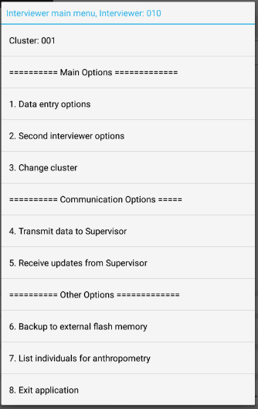

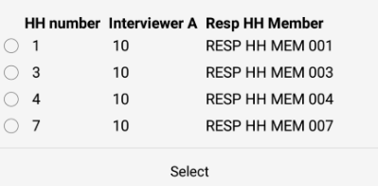
Navigate to form in CAPI
From interviewer main menu, option 1 and choose HH
Choose correct household:

Slide 7
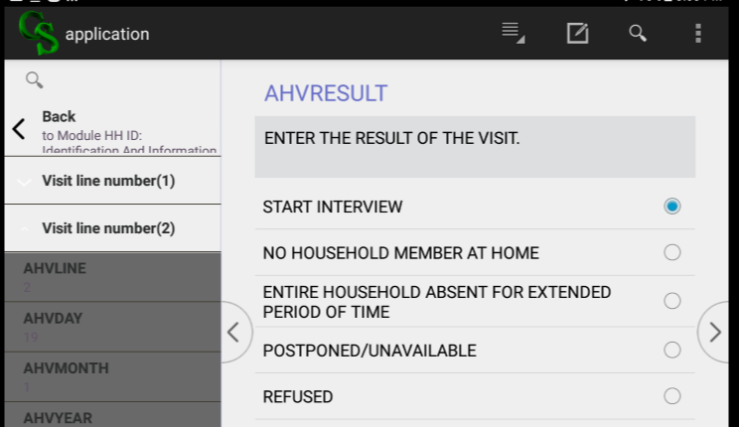

Navigate to form in CAPI
Notes:
From any screen, meaning - (i.e. this one if reentering the QRE or the end of module 2 if continuing on…)

Slide 8
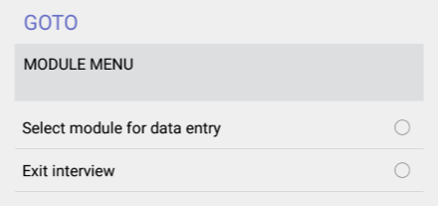
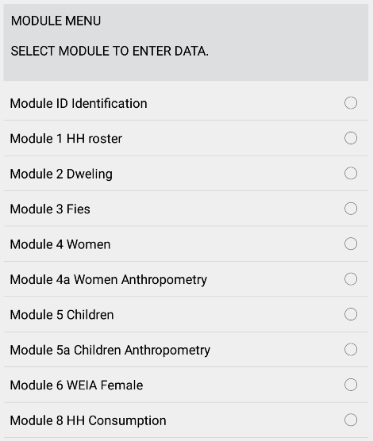
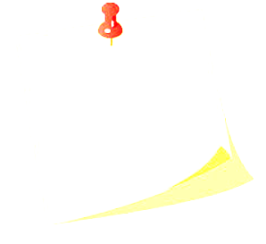
Navigate to form in CAPI
Module 4 – Women’s nutrition and Module 5 – Children’s nutrition must be complete prior to filling in anthropometry modules

Slide 9
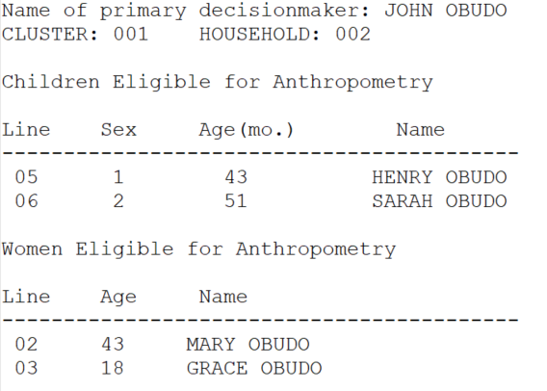
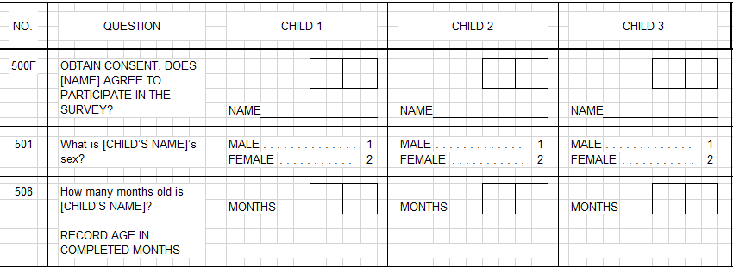
Check order of form
MUST be in order of line number!
0 5
0 6
HENRY
SARAH
4 3
5 1
Notes:
Notice everything goes by line number!!!
ASK: what are reasons it must go by line number? (see next slide)

Slide 10
Check order of form
Why check? Why does it matter?
Line numbers link everyone in survey
Consistency of age in HH and nutrition/anthropometry is checked – via line number
Wrong order makes lots of editing for your ICDM/secondary editors
And most important…
4. WRONG LINE NUMBER, WRONG PERSON…
WRONG ANTHROPOMETRY DATA!!!
Notes:
Line numbers link – only way to match child to HH to nutrition/anthro
This is done during editing

Slide 11
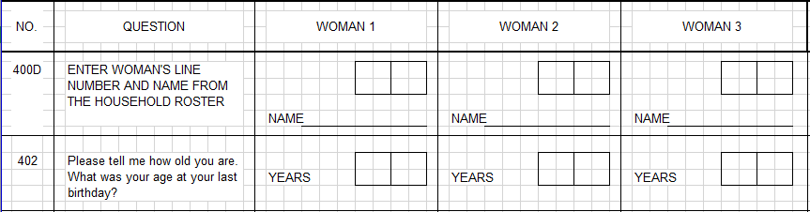
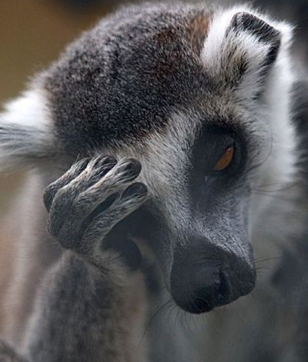
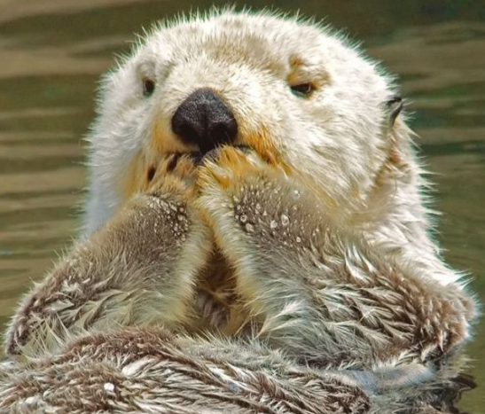
Check order of form
What to do if persons out of order:
0 3
0 2
GRACE
MARY
1 8
4 3

Slide 12
Check order of form
Draw arrows indicating change of order in Woman #. Be very clear.
2
1
0 3
0 2
GRACE
MARY
1 8
4 3
Notes:
Why not change every field??
It’s messy and can lead to error!

Slide 13
Enter anthropometry data
Enter data as is.
If data is missing or skips were wrong,
talk to the anthropometrist.
DO NOT MAKE UP DATA!

Slide 14

Enter anthropometry data
Practice!
Enter data from an anthropometry form(s) into first two practice households, using forms from anthropometry training.
Notes:
Use forms… if available. Otherwise make up some and provide it to trainees…

